Slide 1
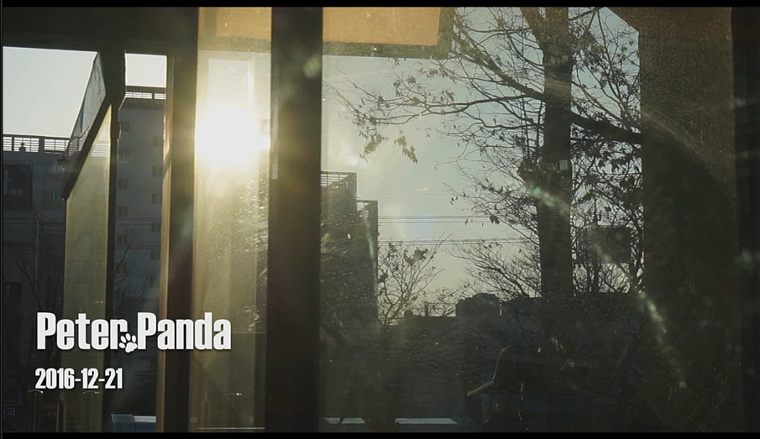

Peter Panda

Slide 2

What We Need MV
You said
You said
You said

Slide 3

What We Need
Peter Panda
Jean

Slide 4
You said you
Have many
precious things \

Slide 5
You said you
Want to
Be something *

Slide 6
You said you’ll’
Gonna be ]}; Everything you want

Slide 7
You said you
Cherish me -
Like _flower `

Slide 8
You said you
Love me |
Like a diamond &

Slide 9
But you always
Sell Everything
You can %[

Slide 10
I don’’”t
wanna be
_flower `

Slide 11

I don’t
wanna be
Gold

Slide 12
I just want to
Be /AIR~ you
breath’’.

Slide 13
Love,=
Love,+
Love{

Slide 14
you,}
you,:
You>

Slide 15
is
You are ALL
that I Need

Slide 16
You are ALL
that I Need

Slide 17
I don’t
wanna be
_flower `

Slide 18
I don’t
wanna be
Gold

Slide 19
I just want to
Be /AIR~ you
breath’’.

Slide 20
I don’t
wanna be
diamond

Slide 21
I don’t
wanna be
Ruby

Slide 22
I just want you to
Hold me - tight

Slide 23
Love,=
Love,+
Love{

Slide 24
you,}
you,:
You>

